Slide 1
Assistive Communication Web App
PIP2001 Capstone Project
Review-4
Batch Number: 11
Roll Number | Student Name
20211CSE0345 20211CSE0295 20211CSE0317 20211CSE0335 | Bhanu Prakash N Vishnu Karthik S S R Bharath P S Venkat Karthik
Under the Supervision of,
Mr. Ramesh T
Assistant Professor
School of Computer Science and Engineering
Presidency University
Name of the Program: CSE
Name of the HoD: Dr. Asif Mohammed H.B
Name of the Program Project Coordinator: Mr. Amarnath J.L & Dr. Jayanthi. K.
Name of the School Project Coordinators: Dr. Sampath A K / Dr. Abdul Khadar A / Mr. Md Ziaur Rahman

Slide 2
Content
Introduction
Literature Review
Objectives
Research Gaps Identified
Experimental Details
Methodology
System Design & Implementation
Timeline of the Project (Gantt Chart)
Outcomes
Conclusion
References
GitHub Link
Publication Details

Slide 3
Introduction
Effective communication is essential for interaction in everyday life. However, individuals with speech and hearing impairments often face significant challenges.
This presentation explores an assistive communication web app that integrates speech recognition, Head Gaze analysis, and sign language interpretation to enhance communication capabilities.

Slide 4
Literature Review
Existing Methods:
Speech Recognition Systems: Convert spoken words into text. High accuracy but may struggle in noisy environments.
Head Gaze Technology: Analyzes head movements. Limited by visibility and requires training.
Sign Language Recognition: Captures gestures and translates them. Effective but limited by variations in sign languages.
Text-to-Speech Systems: Converts written text back to speech. Useful for non-verbal users but lacks personalization.
Augmentative and Alternative Communication (AAC) devices: Help users communicate via symbols or text. Hardware limitations can restrict usability.
Voice-controlled Assistants: Enable interaction through voice commands. Limited to simple tasks.
Mobile Applications: Some apps offer basic recognition capabilities but may lack integration.
Gesture Recognition Systems: Recognize hand movements but can be affected by lighting and camera quality.

Slide 5
Literature Review
Advantages:
1. Integrates multiple communication methods.
2. Real-time processing capabilities.
3. Enhances user independence.
4. Customizable to user preferences.
Limitations:
1. High resource demand for processing.
2. Potential accuracy issues with background noise.
3. User training may be necessary.
4. Dependency on technology availability and connectivity.

Slide 6
Objectives
To develop a user-friendly web application that supports Speech, Head and Sign language.
To achieve high accuracy in real-time communication.
To provide customizable settings for diverse user needs.
To ensure accessibility across various devices and platforms.

Slide 7
Research Gaps Identified
Regional accents, dialects, and non-standard pronunciations can also affect accuracy.
Requires unobstructed visibility of the user's head and often demands significant training for effective usage.
Effectiveness is limited by variations in regional and personal sign language usage. Performance can also be affected by camera resolution, lighting, and user movement.
High cost and hardware limitations can restrict usability. Portability and ease of access are often concerns

Slide 8
Experimental Details
Hardware Used:
Webcam for capturing lip movements.
Microphone for voice input.
Computer for processing data.
Software Used:
Programming languages: Python, JavaScript.
Libraries: TensorFlow for machine learning, OpenCV for image processing.
APIs for speech recognition and gesture analysis.

Slide 9
Methodology
The system is divided into three primary modules:
Speech-to-Text & Text-to-Speech
Head-Gaze Interaction
Sign Language Recognition
Each module is interconnected via a central processing hub that ensures smooth communication between components. The architecture also includes:
User Interface (UI): Provides easy navigation for users.
Backend Processing Unit: Hosts machine learning models and performs real-time computations.

Slide 10
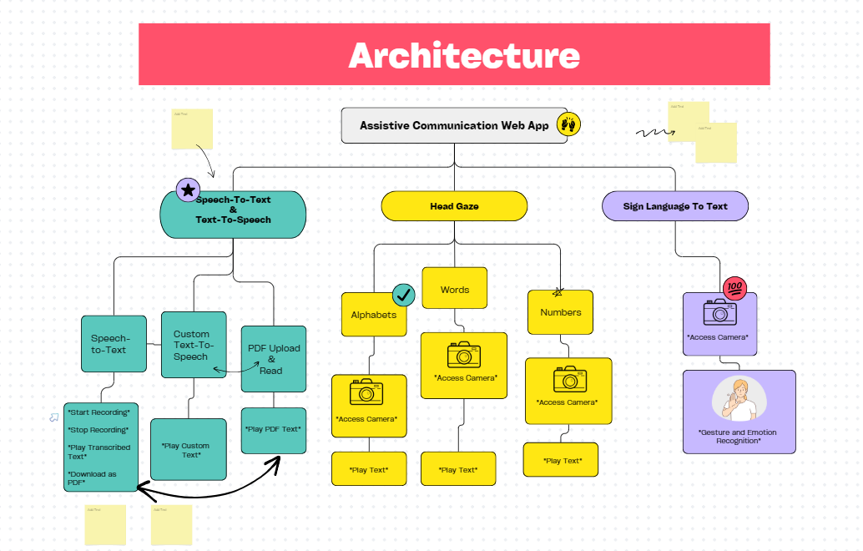
System Design & Implementation
Input Processing: Capture speech
and visual data.
Feature Extraction: Analyze head
movements and extract speech features.
Data Integration: Combine results from
speech, head noding, and sign language.
Output Generation: Display text in
real-time. Outcomes Project Architecture

Slide 11
System Design & Implementation
The implementation of this system would involve the following steps:
Frontend Development: A user-friendly web interface for interaction. And Features like buttons for recording, uploading PDFs, accessing the camera, and playing text.
Backend Development: A server-side application to handle data processing and API integration. Communication with the text-to-speech and speech-to-text APIs.
APIs and Libraries:
Speech Recognition: Use APIs like Google Cloud Speech-to-Text or Azure Cognitive Services.
Text-to-Speech: Utilize APIs like IBM Watson, or Google's TTS.
Head Gaze Tracking: Implement gaze and head motion tracking using libraries like OpenCV or TensorFlow.
Sign Language Recognition: Employ machine learning models trained with datasets for sign language and emotion recognition.

Slide 12
System Design & Implementation
Hardware Integration:
The system leverages cameras for gesture, gaze, and sign language recognition.
Ensure compatibility with different devices (desktop, mobile, and tablets).
Data Storage:
Store user data, uploaded PDFs, and system logs in a database (e.g., MySQL, PostgreSQL, or MongoDB).
Testing and Deployment:
Test the modules for accuracy and robustness, especially for speech, gaze, and gesture recognition.
Deploy the application on cloud platforms like AWS, Azure, or Google Cloud for scalability and availability.

Slide 13
Timeline of the Project (Gantt Chart)
Phase 0: Requirements Gathering
Phase 2: Algorithm and Development
This phase involves conducting surveys, interviews, and workshops to understand the needs of stakeholders and beneficiaries.
This phase involves 50% of implementation details with live demo of the project and 50% of report softcopy.
0
1
2
3
4
Phase 1: System Design & Development
Phase 3: Monitoring and Evaluation
This phase focuses on designing the software and hardware components of the system, Architecture and proposed method
This phase involves continuous monitoring of the system's performance and collecting feedback from beneficiaries to identify areas for improvement.

Slide 14
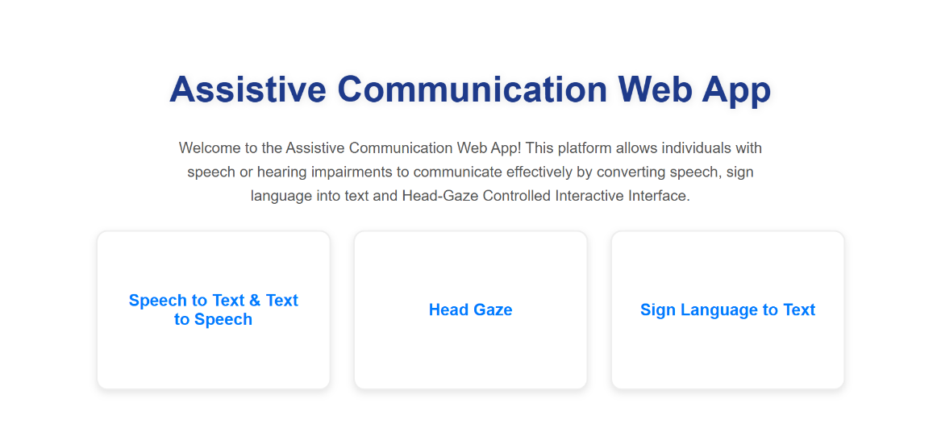
Outcomes
A fully functional prototype of the web application
Enhanced communication capabilities for users with impairments.
Positive user feedback to guide future improvements.
Potential for wider implementation across assistive technologies.

Slide 15
Conclusion
The Assistive Communication Web App integrates advanced technologies like MediaPipe and TensorFlow.js to provide features such as head-gaze control, speech-to-text, and sign language recognition, addressing diverse communication needs.
Its user-centric design ensures inclusivity with hands-free navigation, gesture-to-text translation, and real-time feedback across various contexts.
By prioritizing real-time interactivity, the app empowers users to connect and engage independently with their environment.
Its scalable framework allows future enhancements, like multilingual support and advanced AI features, setting a new standard in assistive technologies.

Slide 16
References (IEEE Paper format)
https://arxiv.org/html/2403.01087v1
https://www.sciencedirect.com/science/article/pii/S2666307422000031
https://www.researchgate.net/publication/380297513_Lip_Reading_System_for_Speech-Impaired_Individuals
https://www.iosrjournals.org/iosr-jce/papers/Vol26-issue4/Ser-3/B2604031018.pdf
https://www.ncbi.nlm.nih.gov/pmc/articles/PMC9452925/

Slide 17

Github Link
Source Code!!
The project code and documentation are available on GitHub, facilitating collaboration and transparency.

Slide 18
Publication Details
Title : “ Assistive Communication Web App: A Multi-Model Solution for Individuals with Disabilities ”
Link → Paper Publication

Slide 19
THANK YOU

